Slide 1
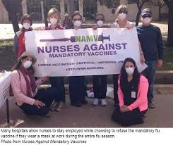
Ethical Issues in Healthcare
Mandatory Influenza Vaccination

Slide 2

Introduction
The condition is an acute respiratory illness caused by influenza virus
Affects lower and upper respiratory tract, usually of type A and B
Disease control centers have been advocating for mandatory vaccination of health workers since 1981.
The primary purpose is to reduce transmission to other health workers and patients
Currently, the prevention centers require clinicians to be vaccinated annually
The paper will provide a stand on whether mandatory influenza vaccination is necessary for all health workers.
Notes:
Healthcare influenza is an acute condition that affects the lower and upper side of the respiratory tract. It can be classified into two types, type A and type B. A considerable number of healthcare facilities have been advocating for mandatory vaccination of healthcare workers to suppress its contraction to healthcare workers and patients. The issue has raised several ethical issues because the rule is believed to infringes on the freedom and rights of nurses. In the recent past, nursing facilities have been encouraging the annual vaccination of clinicians. In light of the above, the paper will provide a stand on whether mandatory influenza vaccination is necessary for all health workers

Slide 3
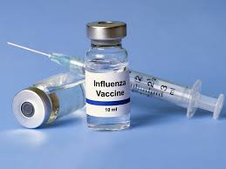
Stance and its rationale
I would support mandatory influenza vaccination on healthcare workers
Influenza vaccination is vital to suppress the disease- it leads to 500,000 deaths annually.
should be administered without considering the views of healthcare workers
The measure has not taken root since it is practiced by less than 50% of entire health centers
Countries advocating for mandatory vaccination have minimal cases of flu
Notes:
In my opinion, I would support mandatory influenza vaccination on healthcare workers, although it tends not to honor the dignity of the nurse's body. Dubov & Phung (2015) suggest that influenza vaccination is vital in suppressing the disease because it leads to 500,000 deaths annually if not contained appropriately. The vaccination should not be guided by nurse's views . Dubov & Phung (2015) further opine that mandatory vaccination seems not to be effective since it is practiced by less than 50% of entire health centers. Besides, the practice is much far away affective in countries which has made it a mandatory requirement.

Slide 4
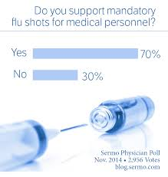
Stance and its rationale
It is vital for an annually mandatory fascination to be put in place.
Overall, the vaccine has been proven to be 90% effective
Nurses have close conduct with flu patients
Nurses have been running campaigns against vaccination, yet it hugely reduces mortality.
It should be a mandatory requirement for all health workers
Notes:
It is worth to put in place an annual mandatory vaccination against flu for nurses. Notably, administration of flu vaccination has been proven to be 90% effective, and it is evident that it can prevent contraction of the disease (Dubov & Phung, 2015) . Again, it must be mandatory on nurses since they interact with many patients who may have the flu. It hurts to see nurses running campaigns against vaccination, yet the disease is a major threat to citizens lives. Importantly, it should be a mandatory requirement for all health workers

Slide 5
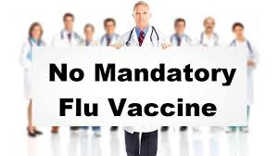
Ethical principles
It is an ethical consideration for the authority to review and evaluate the vaccine to uphold health jurisdiction.
It is ethically fit to ensure compulsory vaccination strategies are followed.
Need to address the nurses on the need for vaccination.
Awareness should be created to the public as well to take part in the prevention process
Focusing more on programmatic areas for health workers to accept the vaccination
Notes:
Various ethical principles guide mandatory vaccination against influenza. Among the major principles is the need for health facilities to review and evaluate the vaccine, thereby upholding the provisions of health jurisdiction (Leifer, 2015). The second principle instructs nursing facilities to ensure that compulsory vaccination strategies are followed. Again, it is the primary role of healthcare administrators to address the nurses on the need for vaccination. The next principle suggests that awareness should be created to the public as well to take part in the prevention process (Leifer, 2015). The fifth principles instruct the nursing facilities to focus more on programmatic areas for health workers to accept the vaccination.

Slide 6
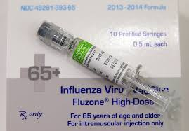
Theories
Positivist theories focus on physical and social perspectives of a vaccine
Functionalism theory insists that vaccines should respect the community’s morality
Social construction theory suggests that healthcare authorities must not concentrate on a single view
Postmodern theory instigates healthcare workers to volunteer for vaccination, to modernize prevention methods.
Critical theory suggests that vaccination information should be socially coherent and guided by the interest of knowledge.
Notes:
Mandatory vaccinations against influenza disease are associated with several theories. Among the approaches is functionalism theory, which suggests that those administering vaccines should respect the community’s morality, by preventing infections (Dyer, 2017). Again, social construction theory advises healthcare authorities not to concentrate on nurses views, but focus on saving the citizens lives. On its part, positivist theories encourage administrators to focus on both the physical and social aspects of the vaccine. Besides, postmodern theory instigates healthcare workers to volunteer for vaccination, or be forcefully vaccinated (Dyer, 2017).Lastly, we have a critical approach which enlightens that vaccination information should be socially coherent, and guided by the interest of knowledge.

Slide 7
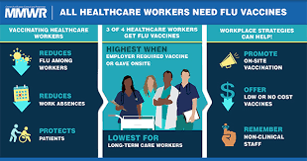
Supporting Evidence
A case of NICU hospital analyzed by Stead et al. (2019) suggested that nurses were the primary cause of influenza spread.
Although the nurses were not tested in a laboratory, positive symptoms of influenza were noticed
Vaccinated nurses in the nursing facility were 5%, and 70% of patients contracted flu from the hospital
The nurses failed to comply with rules because the process was mandatory
The mandatory vaccination could aid in minimizing infection in
Notes:
Stead et al. (2019) analyzed a case of NICU hospital, which was to provide evidence that nurses are the primary cause of influenza spread and should forcefully vaccinated. Although the nurses were not tested in a laboratory, positive symptoms of influenza were noticed amid themselves (Stead et al. 2019). The vaccinated nurses in the hospitals represented 5% of the entire staff. It was unfortunate that the disease was passed to the patients, infecting 70% of total patients from the hospital, both in-patient and outpatient.

Slide 8
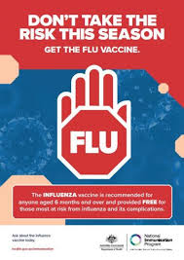
Proposed resolution
Influenza vaccination among nurse is vital, and should be mandatory
Health workers should be taught the significance of influenza vaccination.
The authorities should ensure that the side effects of vaccination do not impact the health of nurses
Health instructors should protect the integrity of the nurse's bodies.
Health centers should be advocates of mandatory influenza vaccination.
Notes:
The following resolution can aid in addressing the ethical issues on mandatory vaccination against influenza. Health workers should be taught the significance of putting in place mandatory influenza vaccination (Leifer, 2015). Besides, influenza vaccination among nurses is vital in suppressing the spread of disease, and it should be mandatory. Again, authorities should ensure that the side effects of immunization do not impact the health of nurses (Stead et al. 2019). Importantly, Health centers should be advocates of voluntary influenza vaccination.

Slide 9

Conclusion
Influenza vaccination is vital in preventing contraction of the disease
Nurses should be forcefully vaccinated
The administrators should not be guided by nurse’s views
It is crucial for mandatory vaccination since nurses come into conduct with many patients
It has been proven that nurses opposes the activity, hence the need of mandatory vaccination.
Notes:
All in all, Influenza vaccination is crucial in preventing the contraction of the disease, thereby saving lives. Since it a killer disease, it is not necessary to consider the views of nurses during vaccination. It is not usually necessary to forcefully vaccinate nurses; however, it is vital to protect the lives of vulnerable patients. Again, the nurse should learn to protect the health of patients and peers by volunteering to be vaccinated. Notably, health authorities need to educate the nurses on the need for urgent mandatory vaccination.

Slide 10

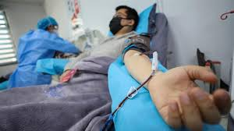
Covid-19 Pandemic
Corona virus has shaken the entire world due to increasing rate of contraction and deaths
The nurses must interact with Covid-19 patients during treatment (Westman, 2020). .
They stand a higher chance of contracting the disease
There should be a mandatory test for nurses before interacting with patient
If they come into conduct with a Corona virus patient without necessary protection, they should be put under self quarantine for 14 days.
Notes:
According to the current research, Corona virus (Covid-19) has hugely shaken the entire world. The disease has led to more than 60,000 deaths within a period of two months. Since the disease is infectious, nurses stands a higher chance of contacting it while treating patients. As a result, there should be a continuous mandatory test for nurses before interacting with new patients. Again, if nurses come into conduct with a Corona virus patient without necessary protection, they should be put under self quarantine for 14 days (Westman, 2020).

Slide 11
References
Dubov, A., & Phung, C. (2015). Nudges or mandates? The ethics of m
Andatory flu vaccination. Vaccine, 33(22), 2530-2535.
Dyer, O. (2017). US healthcare company fires 69 employees for refusing flu vaccination. BMJ: British Medical Journal (Online), 359.
Leifer, C. (2015). Mandatory vaccination will protect all citizens. The Pharmaceutical Journal, 294(7856), 7.
Stead, M., Critchlow, N., Eadie, D., Sullivan, F., Gravenhorst, K., & Dobbie, F. (2019). Mandatory policies for influenza vaccination: Views of managers and healthcare workers in England. Vaccine, 37(1), 69-75
Westman,.N. (2020). Healthcare workers are at high risk of contracting Covid-19.
Retrieved from: https://www.theverge.com/2020/3/5/21166088/coronavirus- covid-19-protection-doctors-nurses-health-workers-risk

